Slide 1


TOPIC: E-mail, Social Networking and e-Governance Services
COURSE: CCC Concept
DAY: 38
Presentation By: Shruti Dubey

Slide 2
Social Networking & e-Commerce
Being the most used and important medium of promotion, social media is serving the most vital purpose in online marketing by helping the companies in establishing a strong web presence, generating leads and getting traffic to an e-commerce business. Every e-commerce business needs a well-structured social media strategy in improving the development and growth of the business. Including the Social media, efforts can be truly beneficial. It provides an effective way to attract a large audience that uses social media.
The medium of rapid growth Businesses are taking advantages of the opportunities it provides to get more customers. If you want to maximize on the potential of social media for your online business then you need to set clear objectives.

Slide 3

Features of Facebook
Facebook allows you to maintain a friends list and choose privacy settings to tailor who can see content on your profile.
Facebook allows you to upload photos and maintain photo albums that can be shared with your friends.
Facebook supports interactive online chat and the ability to comment on your friend's profile pages to keep in touch, share information .
Facebook supports group pages, fan pages, and business pages that let businesses use Facebook as a vehicle for social media marketing.
You can stream video live using Facebook Live.
Chat with Facebook friends and family members, or auto-display Facebook pictures with the Facebook Portal device.

Slide 4
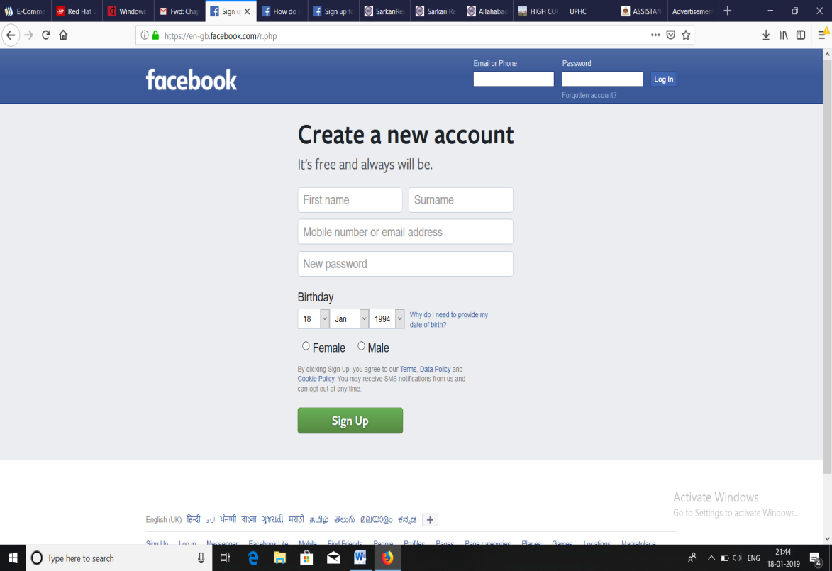
Create a Facebook account:
Follow the given steps to create a new Facebook account
Write www.facebook.com in the address bar of the browser and press enter.
A window will be open with a registration form which has to be filled by the user.
Click on the Sign Up option.
The final step in creating the account is to verify phone number and email id which is provided in the registration form.

Slide 5
Facebook
Facebook is a social networking platform where a user can post comments, share photographs and text post links to news or other interesting content on the web, chat, and watch short-form video.
Facebook began in February 2004 as a school-based social network at Harvard University. It was created by Mark Zuckerberg along with Edward Saverin.

Slide 6

FACEBOOK
Facebook has been marked as the ideal social media platform for creating a brand awareness and customer engagement.
TWITTER
Twitter encourages interaction with customers using the hashtag feature making it easy to interact and share valuable content with the potential buyers. Twitter was created in March 2006 by Jack Dorsey, Noah Glass, Biz Stone, and Evan Williams
Twitter users follow other users. If you follow someone you can see their tweets in your twitter 'timeline'. You can choose to follow people and organizations with similar academic and personal interests to you.
You can create your own tweets or you can retweet information that has been tweeted by others. Retweeting means that information can be shared quickly and efficiently with a large number of people.

Slide 7
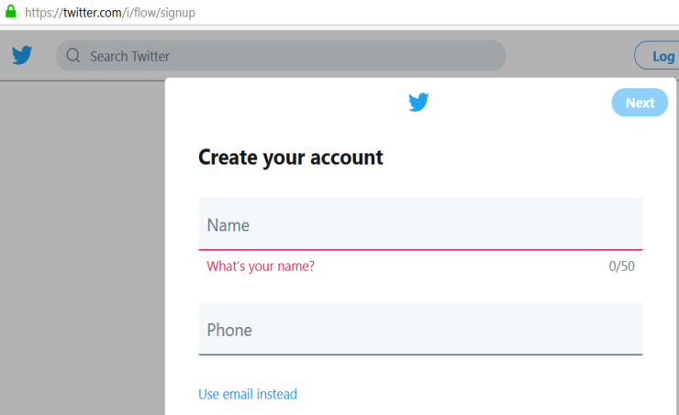
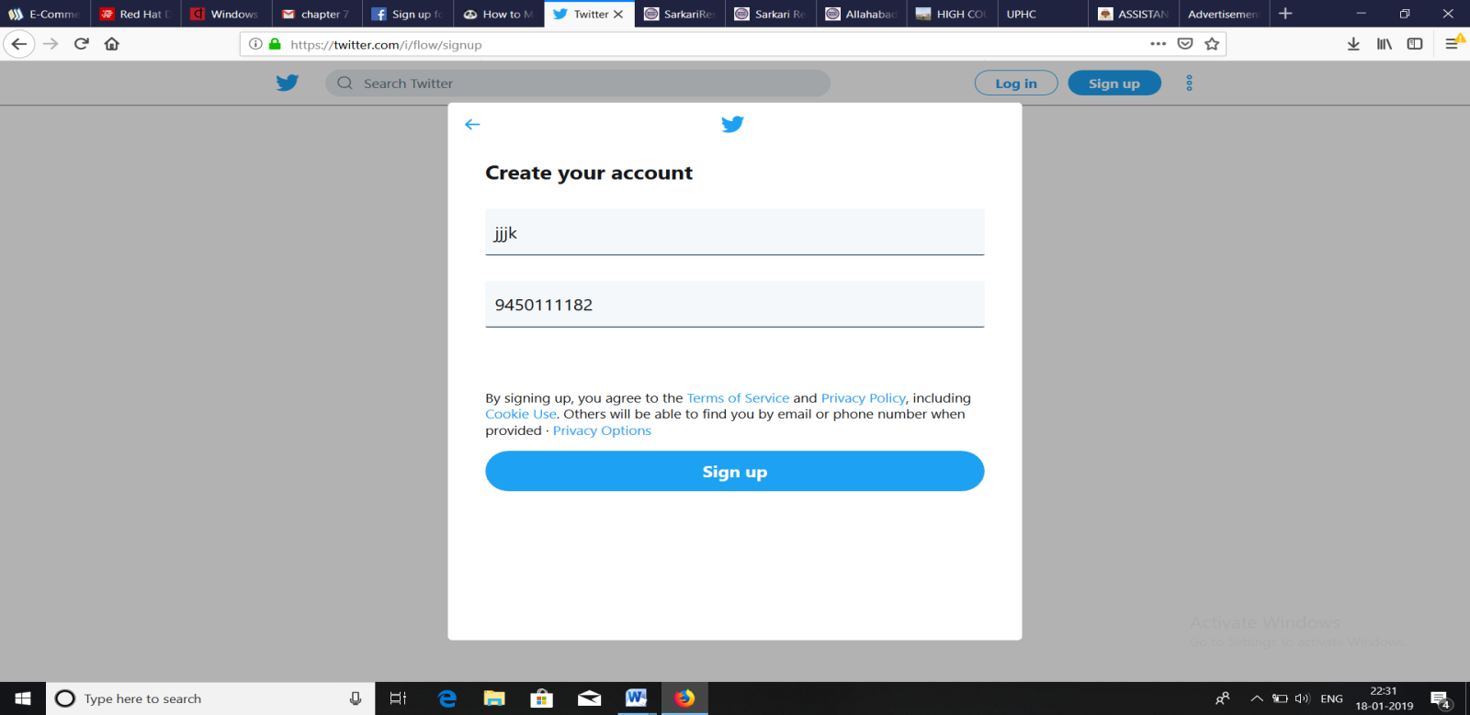
Create a Twitter account
Follow the given steps to create a new Twitter account:
Type https://twitter.com/i/flow/signup in the address bar of the browser.
Write the Name and Email-id/Phone number in Create your account window.
Click on Next option and then click Sign Up option.

Slide 8
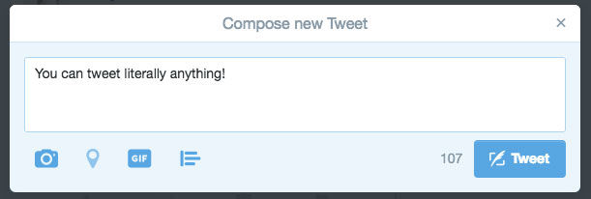
Send a tweet on Twitter
After signing up for the service, click the Tweet button in the upper right.
A message box will be appear where user writes its tweet and can add multiple options like add a photo or video, share location etc.
If user wants to establish a keyword that others can use to add to the conversation, add a hash-tag at the beginning of the keyword. For example-#covid19

Slide 9

Instagram
Instagram is a social networking app (owned by Facebook) made for sharing photos and videos from a smart phone.
Similar to Facebook or Twitter, everyone who creates an Instagram account has a profile and news feed.
When you post a photo or video on Instagram, it will be displayed on your profile.
Followers will see your posts in their own feed. It can also be accessed on the web from a computer browser, but users can only upload and share photos or videos from their devices.

Slide 10
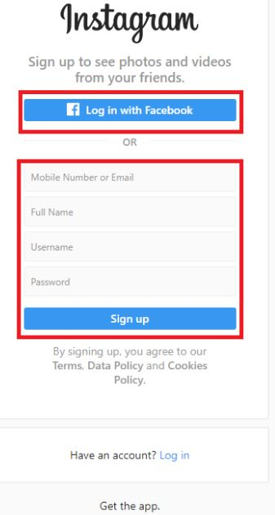
Creating an Account & Username
To create an Instagram account from the app:
Download the Instagram app from the App Store (iPhone) or Google Play Store (Android).
Once the app is installed, tap to open it.
Tap Sign Up With Email or Phone Number (Android) or Create New Account (iPhone), then enter your email address or phone number (which will require a confirmation code) and tap Next. You can also tap Log in with Facebook to sign up with your Facebook account.
If you register with your email or phone number, create a username and password, fill out your profile info and then tap Next. If you register with Facebook, you'll be prompted to log into your Facebook account if you're currently logged out.

Slide 11
Creating an Account & Username
To create an Instagram account from a computer:
Go to instagram.com.
Click Sign up, enter your email address, create a username and password or click Log in with Facebook to sign up with your Facebook account.
If you register with an email, click Sign up. If you register with Facebook, you'll be prompted to log into your Facebook account if you're currently logged out.

Slide 12

LinkedIn
LinkedIn is a business and employment-oriented service that operates via websites and mobile apps. It was founded on December 28, 2002 and launched on May 5, 2003. It is mainly used for professional networking, including employers posting jobs and job seekers posting their CVs. Microsoft acquired LinkedIn in June of 2016 for $26.2 billion.
LinkedIn users create professional, résumé-like profiles that allow other users to learn more about their business background, their areas of expertise, and groups or organizations they belong to. Once users create their profile, they can add other users to their network.

Slide 13

WhatsApp
WhatsApp is the most popular instant messaging application in smart phones. It uses the internet to send messages, images, audio or video.
Using Whatsapp application user can make video calls, make group of their friends, families or colleagues to chat in a group. The maximum number of group participants is 256 users in single group.
WhatsApp is available in most of mobile operating systems and can also be accessed using web browser.
The app lets you make calls, and send and receive messages, documents, photos, and videos. WhatsApp is completely free — with no fees or subscriptions.
WhatsApp is known for its improved privacy features, such as end-to-end encryption, and its free, web-based international calling.

Slide 14
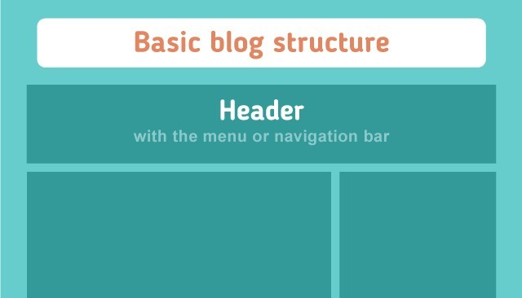
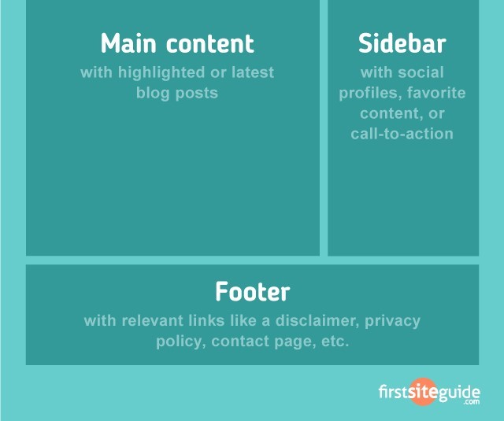
(ii) Introduction to blogs
A blog (shortening of “weblog”) is an online journal or informational website displaying information in the reverse chronological order, with the latest posts appearing first. It is a platform where a writer or even a group of writers share their views on an individual subject.
Blog structure
The appearance of blogs changed over time, and nowadays blogs include different items. But, most blogs include some standard features and structure. Here are common features that a typical blog will include:
Header with the menu or navigation bar
Main content area with highlighted or latest blog posts
Sidebar with social profiles, favorite content, or call-to-action Footer with relevant links like a disclaimer, privacy policy, contact page, etc.

Slide 15


(iii) Basics of E-commerce
E-commerce stands for Electronic commerce. E-commerce refers to a wide range of online business activities for products and services. It also pertains to any form of business transaction in which the parties interact electronically rather than by physical exchanges or direct physical contact. Example- Purchasing online electronic products.
E-commerce is also can do business it can provide a new way to companies of all sizes to create new relationships and extended relational operations on the basis of the website and network activity.

Slide 16
E-commerce Models
There are four main types of ecommerce models that can describe almost every online commercial transaction that takes place between consumers and businesses.
Business to Consumer (B2C)
In this model, an E-commerce website sells its products directly to a customer. A customer can view the products shown on the website. The customer can choose a product and order the same. Example : Amazon, Flipkart, Snapdeal etc.

Slide 17
E-commerce Models(contd..)
Business to Business (B2B)
In B2B business model, a company sells its products to an intermediate buyer. The intermediate buyer then sells the product to the final customer. As an example, a wholesaler receives an order from a retailer. After receiving the consignment, the retailer sells the product to the customer who comes to buy the product at one of its retail outlets.Example: Alibaba.com, IndiaMart.com
Consumer to Consumer (C2C)
A C2C business model helps consumers to sell their assets like residential property, cars, motorcycles, etc., or rent a room by publishing their information on the website.Example: OLX, Quikr, 100acres etc.

Slide 18

E-commerce Models(contd..)
Consumer to Business (C2B)
In this model, a consumer approaches a website showing multiple business organizations for a particular service. For example, the comparison of interest rates of personal loan/car loan provided by various banks via websites. Example :Cars24, Droom-QuickSell etc.

Slide 19
Netiquettes
"Netiquette" refers to Internet etiquette. This simply means the use of good manners in online communication such as e-mail, forums, blogs, and social networking sites, website comments, multiplayer gaming, and other types of online communication.
Some type of unethical behaviour is shown in the social or web world like online bullying, molestation and abuse due to lack of netiquette knowledge.
While there is no official list of netiquette rules or guidelines, the general idea is to respect others online.

Slide 20
Netiquettes Rules:
Always remember that whatever you write or post is seen across the entire world. So it should not hurt any other users.
Always try to maintain the same behaviour on the internet as it is maintained in the real world.
Always accept that anyone can be disagreeing with the given opinion.
Respect other thoughts, emotions and ideas.
Always remember that the user is responsible for destroying its own self reputation by just posting or writing a post or comment.
Always recheck what post or comment before pressing the send button.

Slide 21
Thank you!
www.nielit.gov.in/haridwar

